Slide 1
Time Alignment
EE698V - Machine Learning for Signal Processing
Vipul Arora

Slide 2
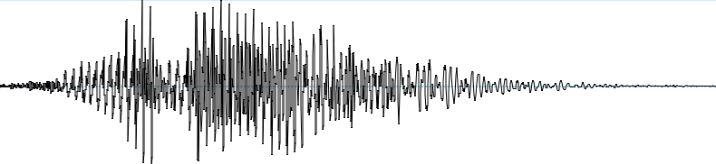

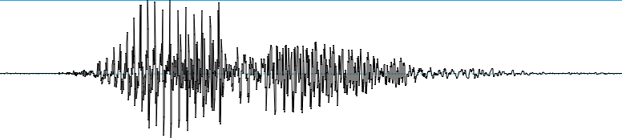
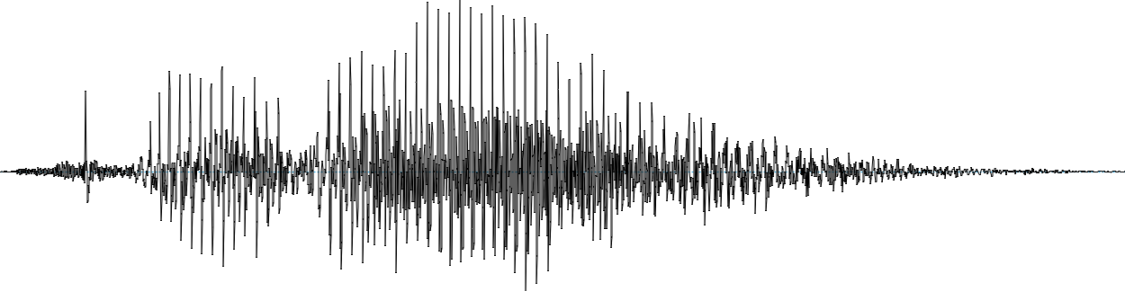
Audio signals – HARI or HARA

Slide 3
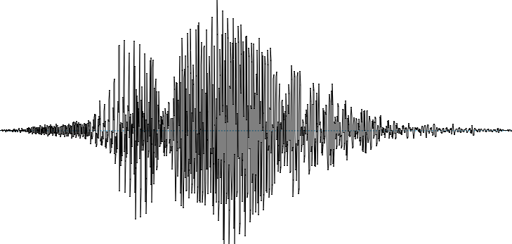
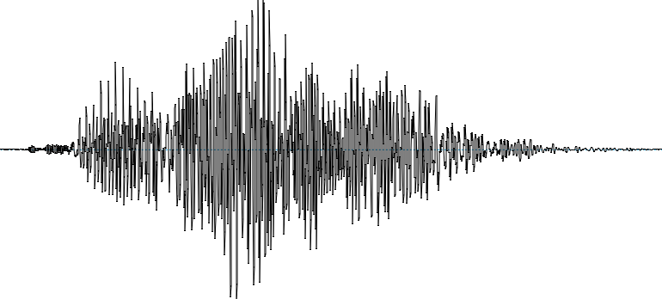
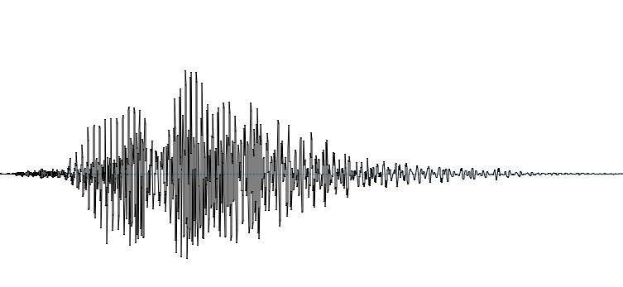
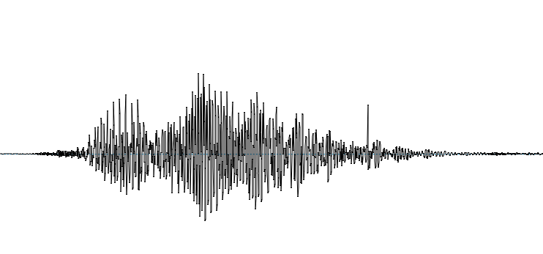
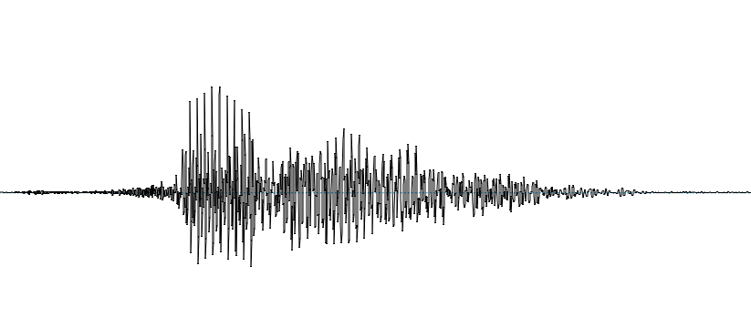
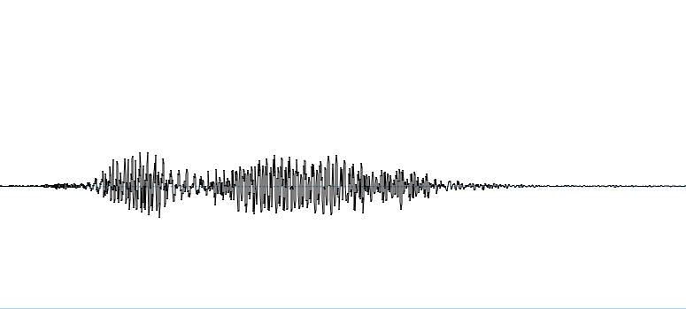
Audio signals – HARI or HARA

Slide 4
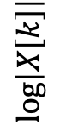
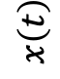
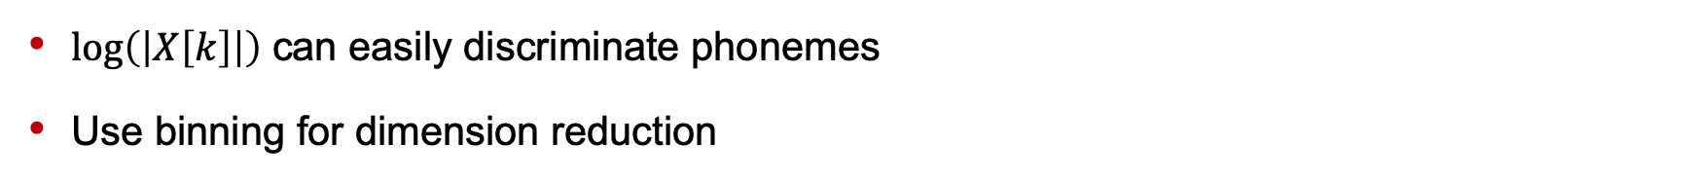
Feature Extraction
$$x\left(t\right)$$
$$\log\left|X\left[k\right]\right|$$
$log\left(\left|X\left[k\right]\right|\right)$ can easily discriminate phonemes
Use binning for dimension reduction

Slide 5
Spectrogram

Slide 6
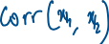
Temporal aspects: Shifting
Patterns could be shifted in time

Slide 7
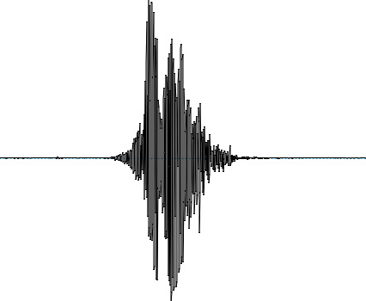
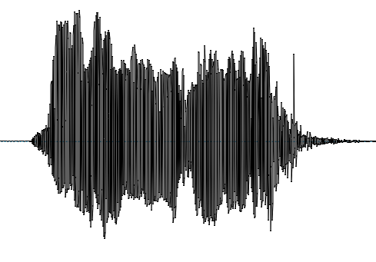
Temporal aspects: Stretching
Patterns could be stretched in time

Slide 8
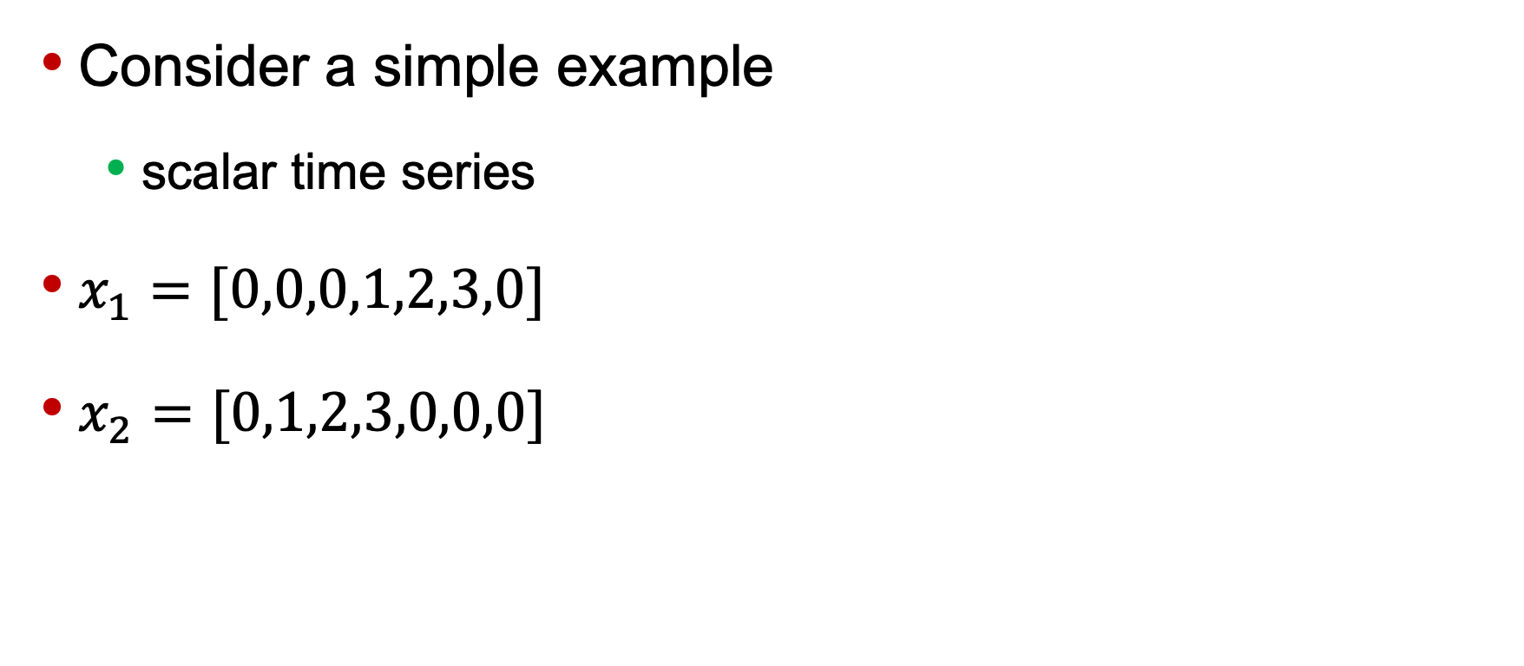
How to align shifted time series
Consider a simple example
scalar time series
$x_{1}=[0,0,0,1,2,3,0]$
$x_{2}=[0,1,2,3,0,0,0]$

Slide 9
How to align shifted time series
Max Cross-Correlation
Will take care of noise also

Slide 10
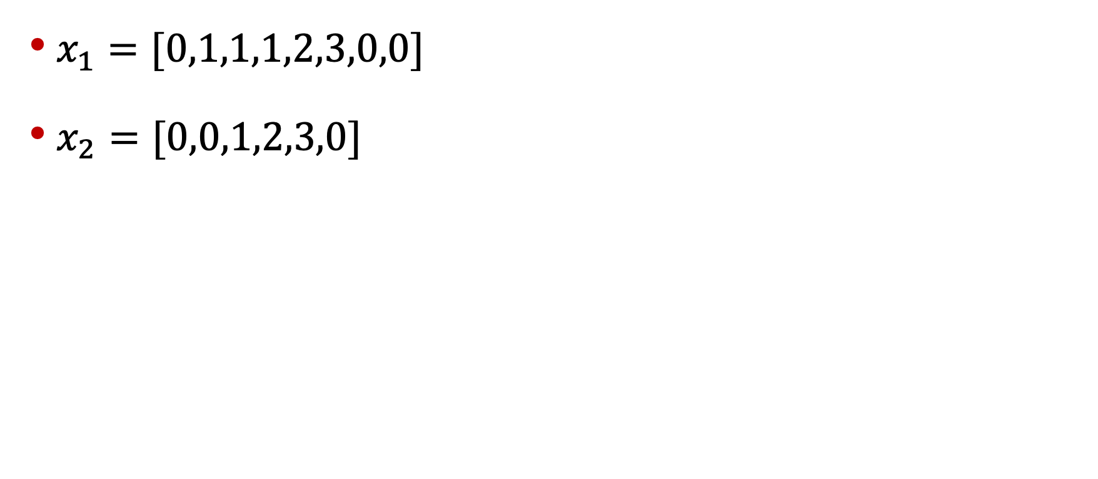
How to align stretched time series
$x_{1}=[0,1,1,1,2,3,0,0]$
$x_{2}=[0,0,1,2,3,0]$

Slide 11
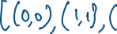
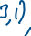
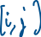
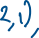
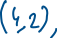

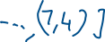
Aligning time series

Slide 12
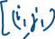
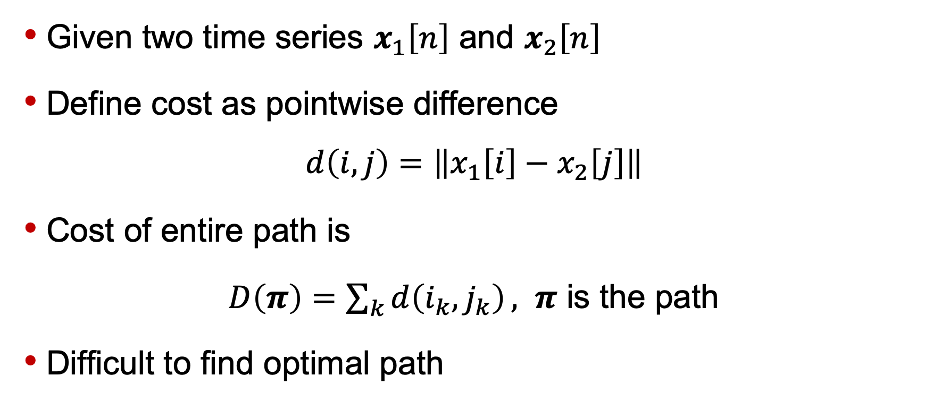
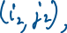
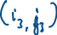
Dynamic Time Warping (DTW)
Given two time series $x_{1}\left[n\right]$ and $x_{2}\left[n\right]$
Define cost as pointwise difference
$$d\left(i,j\right)=\left\|x_{1}\left[i\right]−x_{2}\left[j\right]\right\|$$
Cost of entire path is
$D\left(π\right)=\sum_{k}{d\left(i_{k},j_{k}\right)}, π$ is the path
Difficult to find optimal path

Slide 13
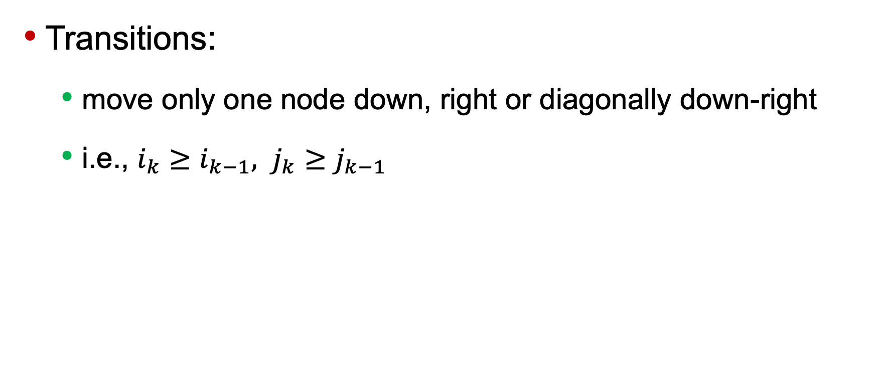
Adding local constraints
Transitions:
move only one node down, right or diagonally down-right
i.e., $i_{k}≥i_{k−1}, j_{k}≥j_{k−1}$

Slide 14
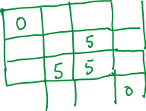


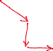
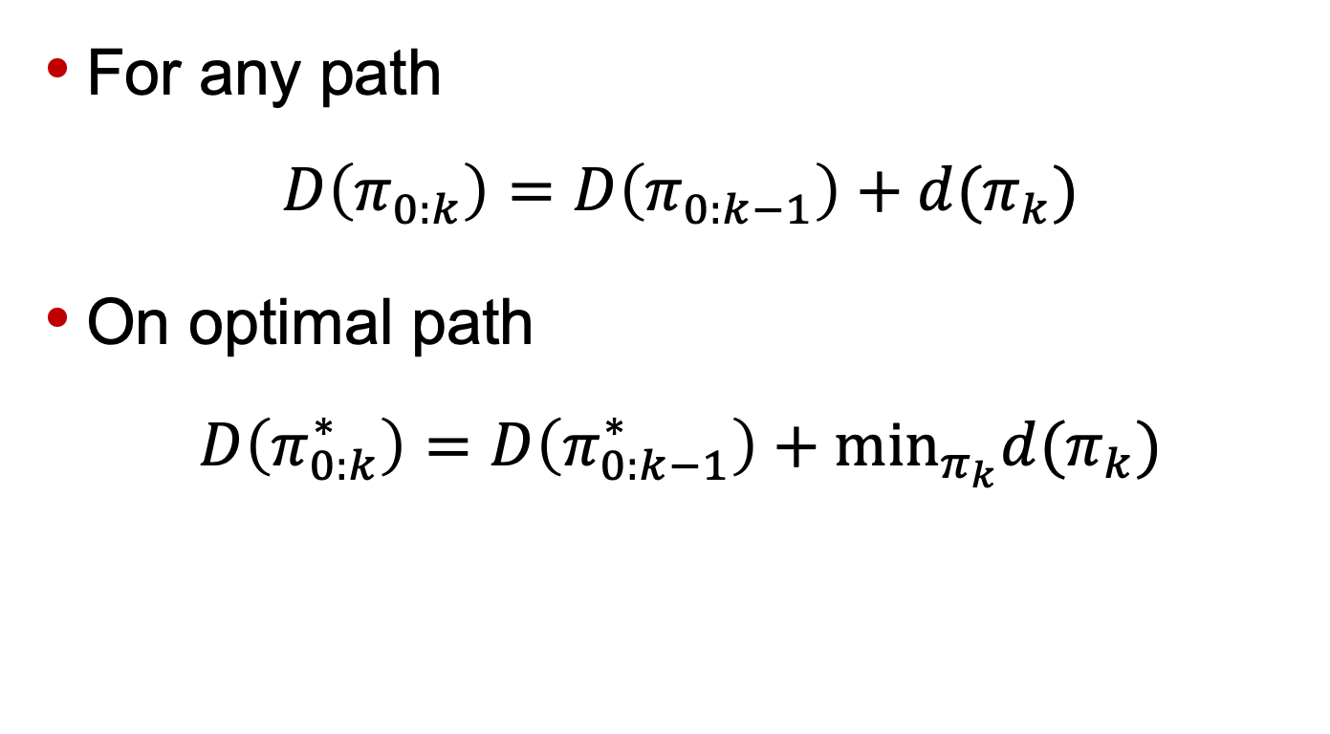
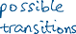
Bellman’s Optimality Principle
For any path
$$D\left(π_{0:k}\right)=D\left(π_{0:k−1}\right)+d(π_{k})$$
On optimal path
$$D\left(π_{0:k}^{∗}\right)=D\left(π_{0:k−1}^{∗}\right)+\min_{π_{k}}d(π_{k})$$

Slide 15
Distance between time series
DTW gives us a way to define a metric for time series
We can use this for recognizing sequences, say speech recognition
Template Matching
Its variants are Edit distance, Viterbi algorithm, etc.
In general, it is called Dynamic Programming

Slide 16
Audio Classification
For your assignment

Slide 17
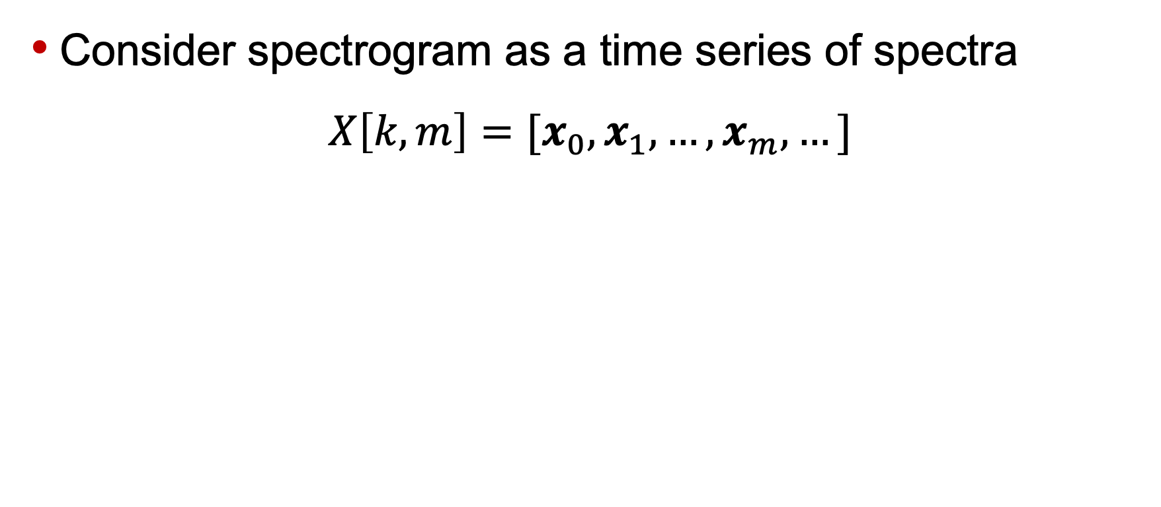
Spectrogram as time series
Consider spectrogram as a time series of spectra
$$X\left[k,m\right]=[x_{0}, x_{1},…,x_{m},…]$$

Slide 18
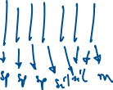
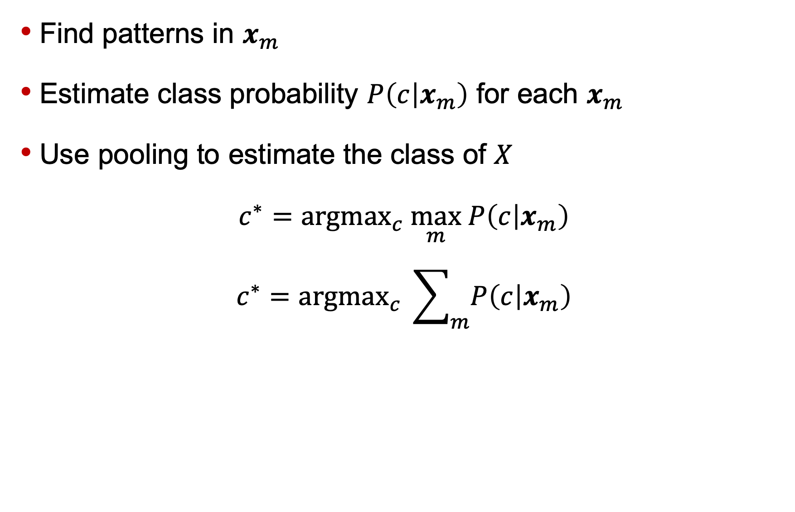

Classification by pooling
Find patterns in $x_{m}$
Estimate class probability $P\left(c | x_{m}\right)$ for each $x_{m}$
Use pooling to estimate the class of $X$
$$c^{∗}={argmax}_{c} \max_{m} P\left(c | x_{m}\right)$$
$$c^{∗}={argmax}_{c} \sum_{m}{P\left(c | x_{m}\right)}$$

Slide 19
Classification by pooling: Drawbacks
You loose temporal information
E.g. clapping
In speech, neighboring phonemes affect each other – coarticulation

Slide 20
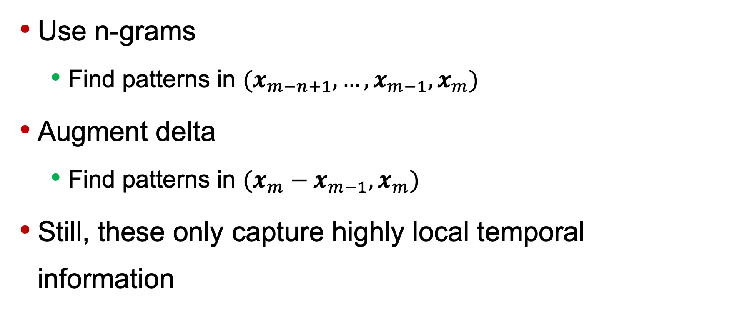
Remedy
Use n-grams
Find patterns in $(x_{m−n+1},…,x_{m−1}, x_{m})$
Augment delta
Find patterns in $(x_{m}−x_{m−1}, x_{m})$
Still, these only capture highly local temporal information

Slide 21
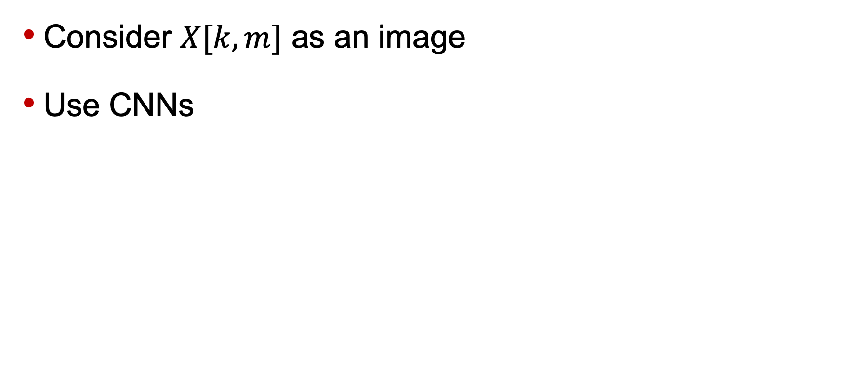
Can we do better?
Consider $X[k,m]$ as an image
Use CNNs

Slide 22
Can we do better?
Models with memory
Recurrent Neural Networks (RNN)
On popular RNN is LSTM (long short term memory)

